Slide 1

Coach Blamey’s Auto Regressive Chat

Slide 2
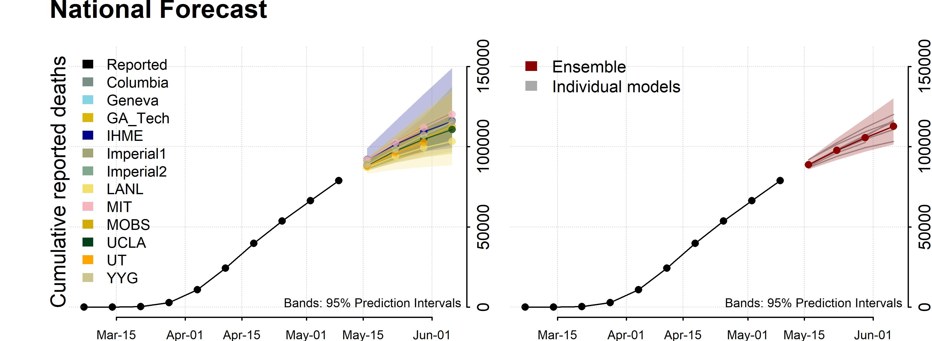
Modeling Covid-19
Numerous classes of models are being used for Covid-19 forecasting
Ensemble Models compensate for relative weaknesses in Individual Models while reinforcing their relative strengths (UMVUE).
COVID-19-Forecasts/COVID-19_Forecast_Model_Descriptions.md at master · cdcepi/COVID-19-Forecasts · GitHub
Notes:
Uniformly Minimum-Variance Unbiased Estimator (UMVUE).
A naive forecast uses the previous period's value to forecast the current period.
An average forecast uses the average value of all the previous periods' values to forecast the current period.
A k-moving average (or k-MA) uses the mean of the time series values for the most recent k periods to forecast the time series value for the next period.
An exponential smoothing forecast is α times the most recent period's time series value, plus (1-α) times the most recent period's forecast value.
We could weight Ensemble models based on Mean Absolute Percentage Error (MAPE).

Slide 3
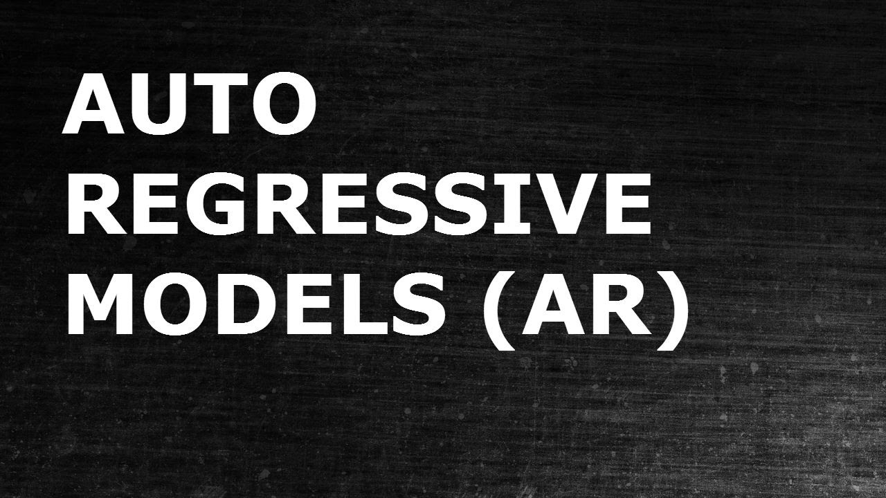
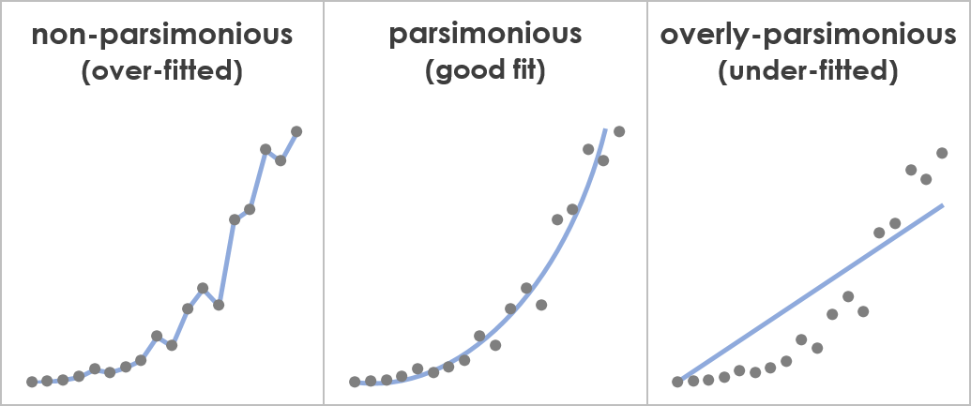
The autoregressive model specifies that the response variable depends linearly on its own previous values, and a stochastic term.
All models are wrong, but some are useful – George Box
Notes:
A time series is affected by four components (non-stationarity), i.e. trend, seasonal, cyclical and irregular components. Linear regression models work best when the predictors are not correlated and are independent of each other. AR models are linear regression models. Autoregressive models are based on the idea that current value of the series, can be explained as a linear combination of past values, together with a random error in the same series.
Direction is easier to discuss than Magnitude ;-0.

Slide 4

Data Wrangling/Cleaning
Data wrangling and data cleaning are two processes that we can perform on data to obtain meaningful data. However, the main difference between data wrangling and data cleaning is that data wrangling is the process of converting and mapping data from one format to another format to use that data to perform analyzing while data cleaning is the process of eliminating the incorrect data or to modify them.
Disease Outbreak Control Division | COVID-19 (hawaii.gov)

Slide 5

Software development environment
Spyder is a scientific integrated development environment written in Python. This software is designed for and by scientists who can integrate with Matplotlib, SciPy, NumPy, Pandas, Cython, IPython, SymPy, and other open-source software. Spyder is available through Anaconda (open-source distribution system) distribution on Windows, macOS, and Linux.
Notes:
Anaconda | Individual Edition

Slide 6

Python Libraries we will be using
Pandas
Matplotlib
NumPy
Statsmodels
Pmdarima

Slide 7
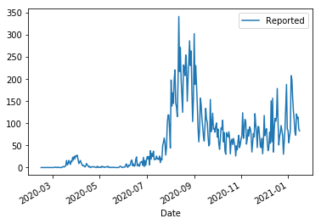
Reading Data into Python
import pandas as pd
# lambda function that converts a string into datetime
dateparse = lambda dates: pd.datetime.strptime(dates, '%m/%d/%Y')
# reads the csv into
df = pd.read_csv(r"C:\TBLAMEY\UH\SP2021\Covid-19\Reported_hono.csv", parse_dates=['Date'], date_parser=dateparse)
ts = df['Reported']
# sets the date column as the index
df = df.set_index('Date')
df.plot()
Notes:
Our Model will be Univariate (only predictor is time series) – but you can consider “exogenous” variables to build a Multivariate model.
Hawaii sign language interpreter for COVID-19 briefings dies of virus during San Diego trip (10news.com)
http://dbedt.hawaii.gov/visitor/daily-passenger-counts/
https://public.tableau.com/profile/docd.epi#!/vizhome/MaskWearingFrequency/MaskDash
https://covid.cdc.gov/covid-data-tracker/#mobility

Slide 8
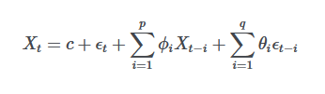
ARIMA Model
Time series are a quite unique topic within forecasting.
In time series the explanatory variables are often not known.
Point is that explanatory variables are not very clear, nor is the explanatory data easily obtainable (as we have seen during the pandemic).
One of the most used models when handling time series are ARIMA models (where the response variable is dependent only on prior time steps – Auto Regressive family).
ARIMA models are actually a combination of two, (or three if you count differencing as a model) processes that are able to generate series data. Those two models are based on an Auto Regressive (AR) process and a Moving Average process.
ARIMA models can work with data that isn’t stationary, but instead has a trend.
When the data show a trend, we can remove the trend by differencing the time steps.
We are assuming no Seasonality (if we assumed Seasonality we would use a SARIMA model).
Notes:
Forecasting is difficult as time series is non-deterministic in nature. Forecasting in general is really tough. In practice, really advanced models do well on in-sample (interpolation) forecasts but not so great out in the wild (extrapolation), as compared to more simpler models. ARIMA models occupy that middle-range area of being simple enough to not overfit while being flexible enough to capture some of the types of relationships you'd see in the data. Including more lags than necessary may result in over-fitting (lag length is an important issue…ie AIC). AR and MA are two widely used linear models that work on stationary time series, and I (differencing the time steps) is a preprocessing procedure to “stationarize” time series if needed.

Slide 9
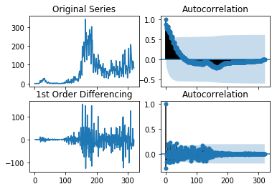
Testing for stationarity.
import pandas as pd
import numpy as np
import statsmodels as sm
import matplotlib.pyplot as plt
from statsmodels.tsa.stattools import adfuller
from statsmodels.graphics.tsaplots import plot_acf, plot_pacf
#Ho: It is non-stationary vs H1: It is stationary
result = adfuller(ts.dropna())
print('p-value: %f' % result[1])
# Original Series plot
fig, axes = plt.subplots(2, 2, sharex=True)
axes[0, 0].plot(ts); axes[0, 0].set_title('Original Series')
plot_acf(ts, ax=axes[0, 1])
result = adfuller(ts.diff().dropna())
print('p-value: %f' % result[1])
# Differencing stabilizes the mean (Reducing Trend)
# 1st Order Differencing plot
axes[1, 0].plot(ts.diff()); axes[1, 0].set_title('1st Order Differencing')
plot_acf(ts.diff().dropna(), ax=axes[1, 1])
p-value: 0.178207 – Original Data (fail to reject Ho – Non Stationary)
p-value: 0.005823 – 1st Differenced Data (reject Ho – Stationary)
Notes:
Most statistical forecasting methods are based on the assumption that the time series can be rendered approximately stationary (stationary time series is one whose statistical properties such as mean, variance, autocorrelation, etc. are all constant over time) after mathematical transformations. We will use the graph of the data, the ACF graph, and the “Adfuller/Augmented Dickey-Fuller” test, to get a general idea of what models should be used – 1st Differenced Model looks good.

Slide 10
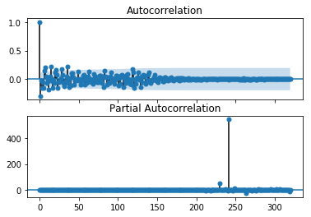
Order of the ARIMA (p,d,q)
import numpy as np
import statsmodels as sm
import matplotlib.pyplot as plt
from statsmodels.tsa.stattools import adfuller
from statsmodels.graphics.tsaplots import plot_acf, plot_pacf
# Original Series plot
fig, axes = plt.subplots(2, 1, sharex=True)
plot_acf(ts.diff().dropna(), ax=axes[0])
plot_pacf(ts.diff().dropna(), ax=axes[1])
Notes:
We will use the ACF and PACF to get a general idea of what models should be used (ACF for Moving Average lags, and PACF for Auto Regression lags). Some software will optimize for the best model automatically.

Slide 11
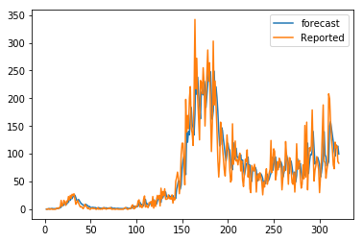
Fitting the ARIMA Model
ARIMA Model Results
==============================================================================
Dep. Variable: D.Reported No. Observations: 321
Model: ARIMA(1, 1, 1) Log Likelihood -1555.944
Method: css-mle S.D. of innovations 30.797
Date: Mon, 18 Jan 2021 AIC 3119.888
Time: 13:41:13 BIC 3134.974
Sample: 1 HQIC 3125.911
====================================================================================
coef std err z P>|z| [0.025 0.975]
------------------------------------------------------------------------------------
const 0.3145 0.529 0.594 0.553 -0.723 1.352
ar.L1.D.Reported 0.3054 0.070 4.367 0.000 0.168 0.443
ma.L1.D.Reported -0.7884 0.038 -20.603 0.000 -0.863 -0.713
Roots
=============================================================================
Real Imaginary Modulus Frequency
-----------------------------------------------------------------------------
AR.1 3.2739 +0.0000j 3.2739 0.0000
MA.1 1.2684 +0.0000j 1.2684 0.0000
import pandas as pd
import numpy as np
import statsmodels as sm
import matplotlib.pyplot as plt
from statsmodels.tsa.arima_model import ARIMA
# 1,1,1 ARIMA Model
model = ARIMA(ts, order=(1,1,1))
model_fit = model.fit(disp=0)
print(model_fit.summary())
# Actual vs Fitted
model_fit.plot_predict(dynamic=False)
plt.show()
Notes:
We can play with a number of different models and analyze their outputs. Here we have selected the ARIMA(1,1,1) Model.
The model fit looks good for say interpolating … but how is it for extrapolation?
All introductory statistics books tell you Never extrapolate outside of your data – and most intermediate statistics texts explain that as you move further outside of the data set…the more uncertainty/error you face.
Box discussed this in his quote on slide #2.

Slide 12
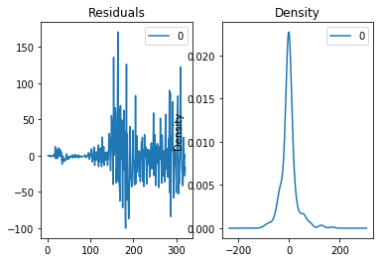
Residual plots to ensure there are no patterns/information left (constant mean and variance).
import pandas as pd
import numpy as np
import statsmodels as sm
import matplotlib.pyplot as plt
from statsmodels.tsa.arima_model import ARIMA
ts = df['Reported']
# 1,1,1 ARIMA Model
model = ARIMA(ts, order=(1,1,1))
model_fit = model.fit(disp=0)
# Plot residual errors
residuals = pd.DataFrame(model_fit.resid)
fig, ax = plt.subplots(1,2)
residuals.plot(title="Residuals", ax=ax[0])
residuals.plot(kind='kde', title='Density', ax=ax[1])
plt.show()
Notes:
The residual errors seem fine (ie are normally distributed with mean = 0, constant variance).

Slide 13
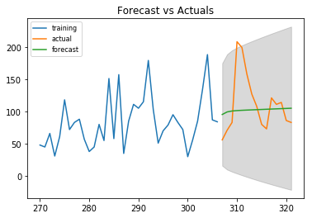
Cross Validating your Model
from statsmodels.tsa.stattools import acf
# Create Training and Test
s = 270; d = 307
train = ts[s:d]; test = ts[d:]
# Build Model
model = ARIMA(ts, order=(1, 1, 1))
fitted = model.fit(disp=-1)
# Forecast
fc, se, conf = fitted.forecast(len(ts)-d, alpha=0.01) # 99% conf
# Make as pandas series
fc_series = pd.Series(fc, index=test.index)
lower_series = pd.Series(conf[:, 0], index=test.index)
upper_series = pd.Series(conf[:, 1], index=test.index)
# Plot
#plt.figure(figsize=(10,5), dpi=100)
plt.plot(train, label='training')
plt.plot(test, label='actual')
plt.plot(fc_series, label='forecast')
plt.fill_between(lower_series.index, lower_series, upper_series, color='k', alpha=.15)
plt.title('Forecast vs Actuals')
plt.legend(loc='upper left', fontsize=8)
plt.show()
Notes:
Create a training and testing dataset by splitting the time series into 2 contiguous parts. Then you compare the forecast against the actuals.
The forecast above may not look very impressive, as it is almost a straight line. This is because this is a very simple, univariate forecasting model. Nonetheless, keep in mind that these simple forecasting models can be extremely competitive.

Slide 14
Auto ARIMA Forecast
Fit ARIMA: order=(1, 1, 1); AIC=3119.888, BIC=3134.974, Fit time=0.047 seconds
Fit ARIMA: order=(0, 1, 0); AIC=3189.163, BIC=3196.706, Fit time=0.000 seconds
Fit ARIMA: order=(1, 1, 0); AIC=3162.134, BIC=3173.448, Fit time=0.031 seconds
Fit ARIMA: order=(0, 1, 1); AIC=3136.600, BIC=3147.914, Fit time=0.016 seconds
Fit ARIMA: order=(2, 1, 1); AIC=3121.111, BIC=3139.969, Fit time=0.085 seconds
Fit ARIMA: order=(1, 1, 2); AIC=3121.571, BIC=3140.428, Fit time=0.069 seconds
Fit ARIMA: order=(2, 1, 2); AIC=3092.257, BIC=3114.886, Fit time=0.156 seconds
Fit ARIMA: order=(3, 1, 2); AIC=3081.968, BIC=3108.368, Fit time=0.161 seconds
Fit ARIMA: order=(3, 1, 1); AIC=3108.247, BIC=3130.875, Fit time=0.090 seconds
Fit ARIMA: order=(3, 1, 3); AIC=3064.358, BIC=3094.529, Fit time=0.527 seconds
Fit ARIMA: order=(2, 1, 3); AIC=3062.935, BIC=3089.335, Fit time=0.342 seconds
Fit ARIMA: order=(1, 1, 3); AIC=3119.239, BIC=3141.868, Fit time=0.120 seconds
Total fit time: 1.643 seconds
ARIMA Model Results
==============================================================================
Dep. Variable: D.y No. Observations: 321
Model: ARIMA(2, 1, 3) Log Likelihood -1524.468
Method: css-mle S.D. of innovations 27.849
Date: Mon, 18 Jan 2021 AIC 3062.935
Time: 13:50:56 BIC 3089.335
Sample: 1 HQIC 3073.476
==============================================================================
coef std err z P>|z| [0.025 0.975]
------------------------------------------------------------------------------
const 0.3133 0.530 0.592 0.555 -0.725 1.351
ar.L1.D.y 1.2276 0.016 75.131 0.000 1.196 1.260
ar.L2.D.y -0.9804 0.014 -69.048 0.000 -1.008 -0.953
ma.L1.D.y -1.7980 0.049 -37.009 0.000 -1.893 -1.703
ma.L2.D.y 1.6163 0.068 23.936 0.000 1.484 1.749
ma.L3.D.y -0.5633 0.044 -12.921 0.000 -0.649 -0.478
Roots
=============================================================================
Real Imaginary Modulus Frequency
-----------------------------------------------------------------------------
AR.1 0.6260 -0.7925j 1.0099 -0.1436
AR.2 0.6260 +0.7925j 1.0099 0.1436
MA.1 0.6605 -0.8429j 1.0709 -0.1442
MA.2 0.6605 +0.8429j 1.0709 0.1442
MA.3 1.5480 -0.0000j 1.5480 -0.0000
import pmdarima as pm
model = pm.auto_arima(ts, start_p=1, start_q=1,
test='adf', # use adftest to find optimal 'd'
max_p=3, max_q=3, # maximum p and q
m=1, # frequency of series
d=None, # let model determine 'd'
seasonal=False, # No Seasonality
start_P=0,
D=0,
trace=True,
error_action='ignore',
suppress_warnings=True,
stepwise=True)
print(model.summary())
Notes:
Python has a Auto ARIMA package (pmdarmima) and it has found ARIMA(2,1,3) to be best.
ARIMA(2,1,3) Model seems better than our original ARIMA(1,1,1) Model.

Slide 15
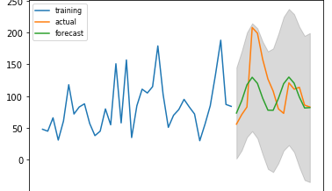
Cross Validating your Model
from statsmodels.tsa.stattools import acf
# Create Training and Test
s = 270; d = 307
train = ts[s:d]; test = ts[d:]
# Build Model
model = ARIMA(ts, order=(2, 1, 3))
fitted = model.fit(disp=-1)
# Forecast
fc, se, conf = fitted.forecast(len(ts)-d, alpha=0.01) # 99% conf
# Make as pandas series
fc_series = pd.Series(fc, index=test.index)
lower_series = pd.Series(conf[:, 0], index=test.index)
upper_series = pd.Series(conf[:, 1], index=test.index)
# Plot
#plt.figure(figsize=(10,5), dpi=100)
plt.plot(train, label='training')
plt.plot(test, label='actual')
plt.plot(fc_series, label='forecast')
plt.fill_between(lower_series.index, lower_series, upper_series, color='k', alpha=.15)
plt.title('Forecast vs Actuals')
plt.legend(loc='upper left', fontsize=8)
plt.show()
Notes:
Create a training and testing dataset by splitting the time series into 2 contiguous parts. Then you compare the forecast against the actuals.
ARIMA(2,1,3) Model.

Slide 16
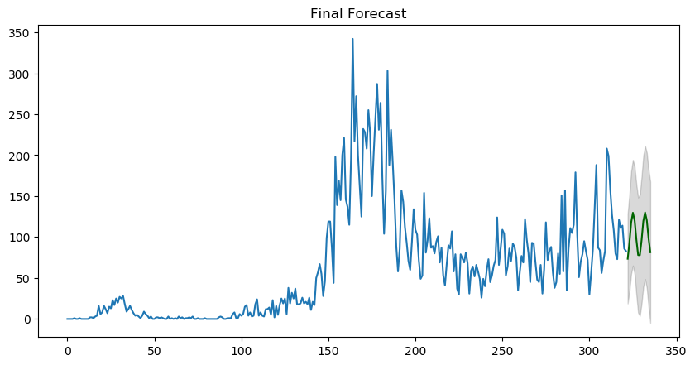
Finally Forecasting (prospectively)
# Forecast
n_periods = 14
fc, confint = model.predict(n_periods=n_periods, return_conf_int=True)
index_of_fc = np.arange(len(ts), len(ts)+n_periods)
# make series for plotting purpose
fc_series = pd.Series(fc, index=index_of_fc)
lower_series = pd.Series(confint[:, 0], index=index_of_fc)
upper_series = pd.Series(confint[:, 1], index=index_of_fc)
# Plot
plt.figure(figsize=(10,5), dpi=100)
plt.plot(ts)
plt.plot(fc_series, color='darkgreen')
plt.fill_between(lower_series.index,
lower_series,
upper_series,
color='k', alpha=.15)
plt.title("Final Forecast")
plt.show()
Notes:
This model is forecasting two weeks ahead.
This is a univariate model…
We might next consider a seasonal component SARIMA and SARIMA (adding ‘exogenous variable/external predictor’ – multivariate).
Many forecasters are using an Autoregressive base model (as SIR models clearly demonstrate…transmission yesterday has an effect on transmission tomorrow).

